Slide 1

MULLARD SPACE SCIENCE LABORATORY
Producing ML-driven Real-Time Forecasts of the Probability of Large Rates of Change of the Surface Magnetic Field in the UK
Andy Smith¹, Colin Forsyth¹, Jonathan Rae², Tadhg Garton³, Mayur Bakrania¹, Caitriona Jackman⁴, Mervyn Freeman⁵, Gemma Richardson⁶, Rob Shore⁵, Mike Heyns⁷, Jonathan Eastwood⁷, Ciaran Beggan⁶, Alan Thomson⁶, Jeff Johnson^{8,9}
¹ Mullard Space Science Laboratory, University College London, Dorking, UK
² Northumbria University, Newcastle upon Tyne, UK
³ University of Southampton, Southampton, UK
⁴ DIAS Dunsink Observatory, Dublin Institute for Advanced Studies, Dublin, Ireland
⁵ British Antarctic Survey, Cambridge, UK
⁶ British Geological Survey, Edinburgh, UK
⁷ Imperial College London, London, UK
⁸ University of Colorado Boulder, Boulder, USA
⁹ Space Weather Prediction Center, NOAA, Boulder, USA
Credit: NASA
March 2022

Slide 2
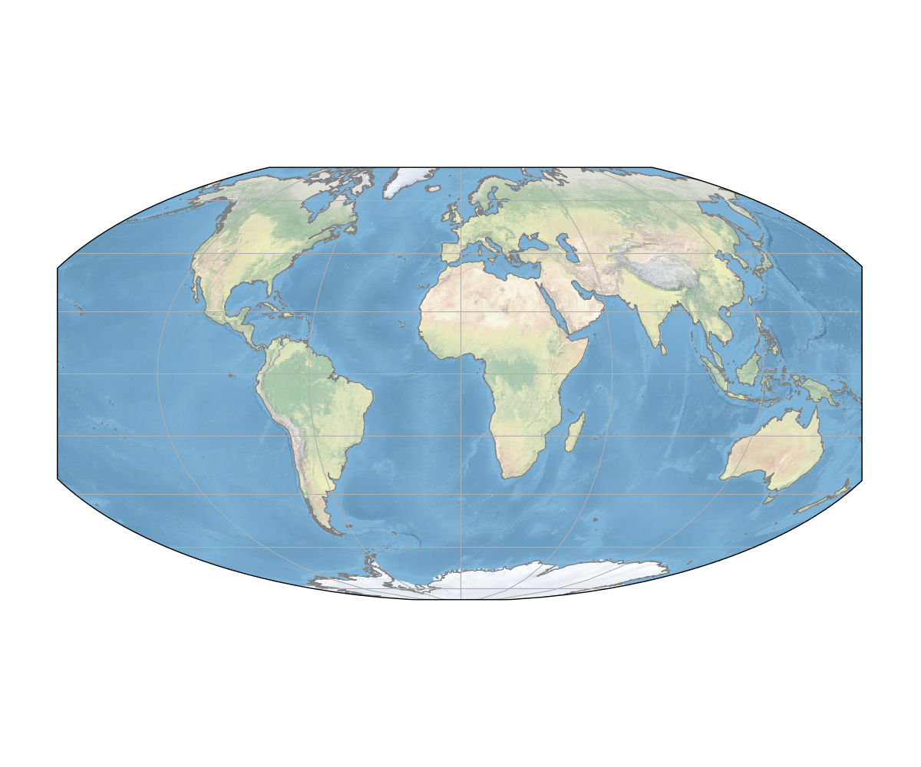
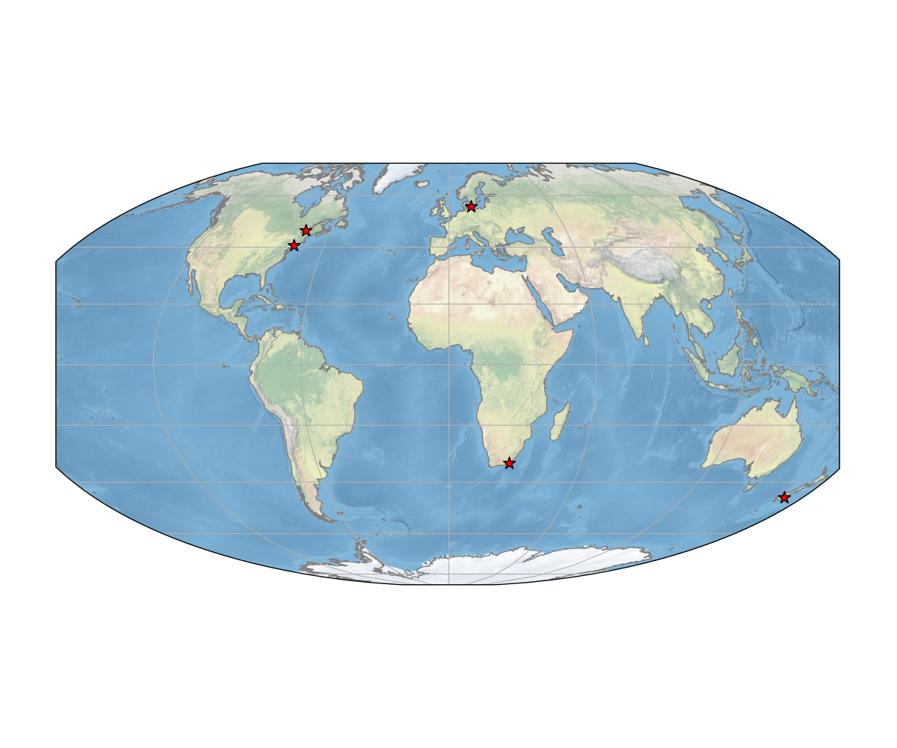
Geomagnetically Induced Currents (GICs)
Quebec, Canada, 1989
[Bolduc, 1991]
Malmö, Sweden 2003
[Pulkkinen et al, 2005]
New Jersey, USA, 1989
[Barnes & Dyke, 1990]
New Zealand 2001
[Rodger et al, 2017]
South Africa 2003
[Gaunt & Coetzee, 2007]
Notes:
In the last 30 years GICs have taken down power networks
Few examples here:
If we could forecast these events, perhaps we could have mitigated them.

Slide 3
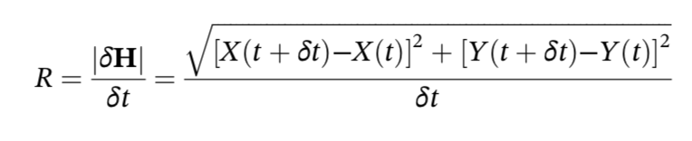
GICs and Proxy Measurements
GIC
Rate of Change of the Magnetic Field
[e.g. Viljanen et al., 2001]
Subsurface Conductivity
[e.g. Beggan et al., 2015]
Power Network Configuration
[e.g. Divett et al., 2018; 2020]
Notes:
GICs are hard.
Also specific to a given infrastructure layout.
Composed of three main aspects.
In this talk I’ll refer to ‘R’, being the vector rate of change.

Slide 4
Forecasting GICs/B
Various types of model have shown good skill at forecasting the ground magnetic field, for example:
Machine Learning Models (e.g. Neural Networks)
[e.g. Wintoft et al., 2015; 2017; Keesee et al., 2020]
Physics Based Models (e.g. MHD)
[e.g. Pulkkinen et al., 2014; Toth et al., 2014; Welling et al., 2019]
Gray Box Models
[e.g. Camporeale et al., 2020]
Precise magnitudes and timings are challenging.
Thresholding and windowing has shown excellent promise.
Notes:
Over the past 5 -10 years several different approaches have shown promise
Machine learning methods
Physics based, e.g. MHD
Combinations of the two.
However, timing of magnetospheric processes is challenging and magnitudes are hard
Thresholding and windowing help to make the problem more tractable.

Slide 5
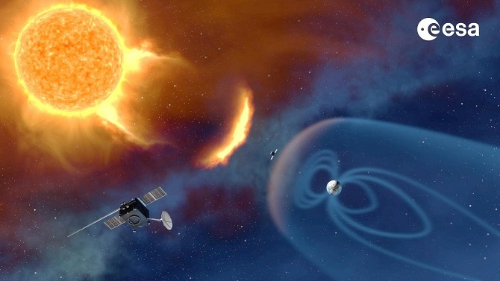
Forecasting - Inputs
Notes:
One thing in common is that all these method are driven from L1
Use upstream solar wind data, derive the result on the ground with a window.

Slide 6
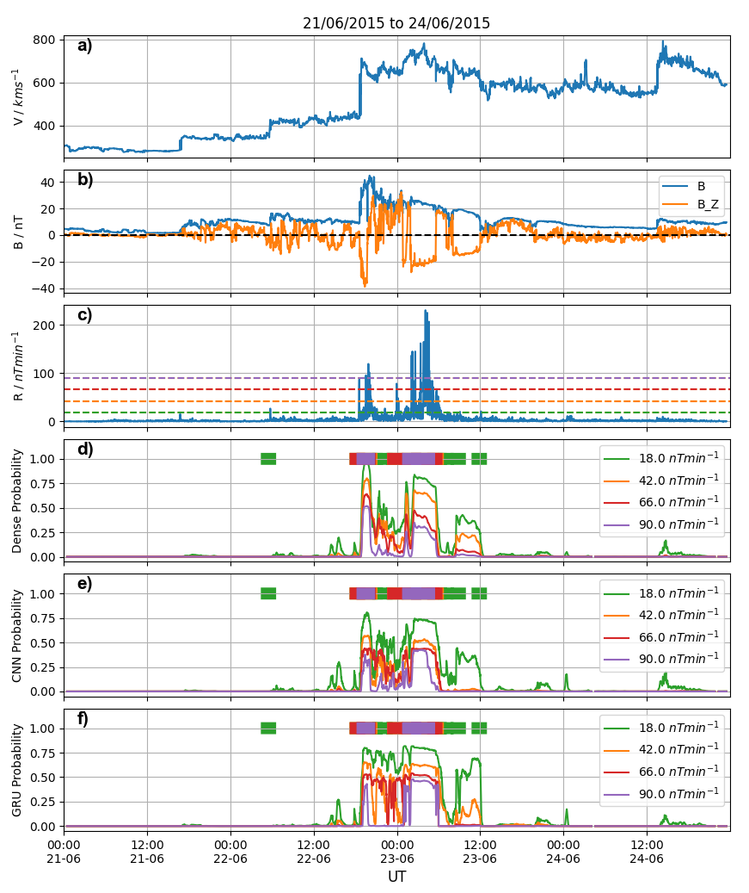
Example Models
Multivariate timeseries classification:
Input Window: 30 minutes
Horizon: 30 minutes
Forecasting ‘R’ at Lerwick in the UK.
Three variants tested:
Feed-Forward (Dense)
Convolutional (CNN)
Recurrent (GRU)
Individual models trained for each threshold of ground magnetic variability.
Smith et al., 2021
Notes:
We’re looking at predicting the prob at LER, taken thresholds from the literature.
Initially take 30 minutes of input solar wind (propagated to the bowshock), forecasting over the next 30 minutes
Interested in how the models use the solar wind data, so trying three models.
Mention that we’re using individually trained models for each threshold.

Slide 7
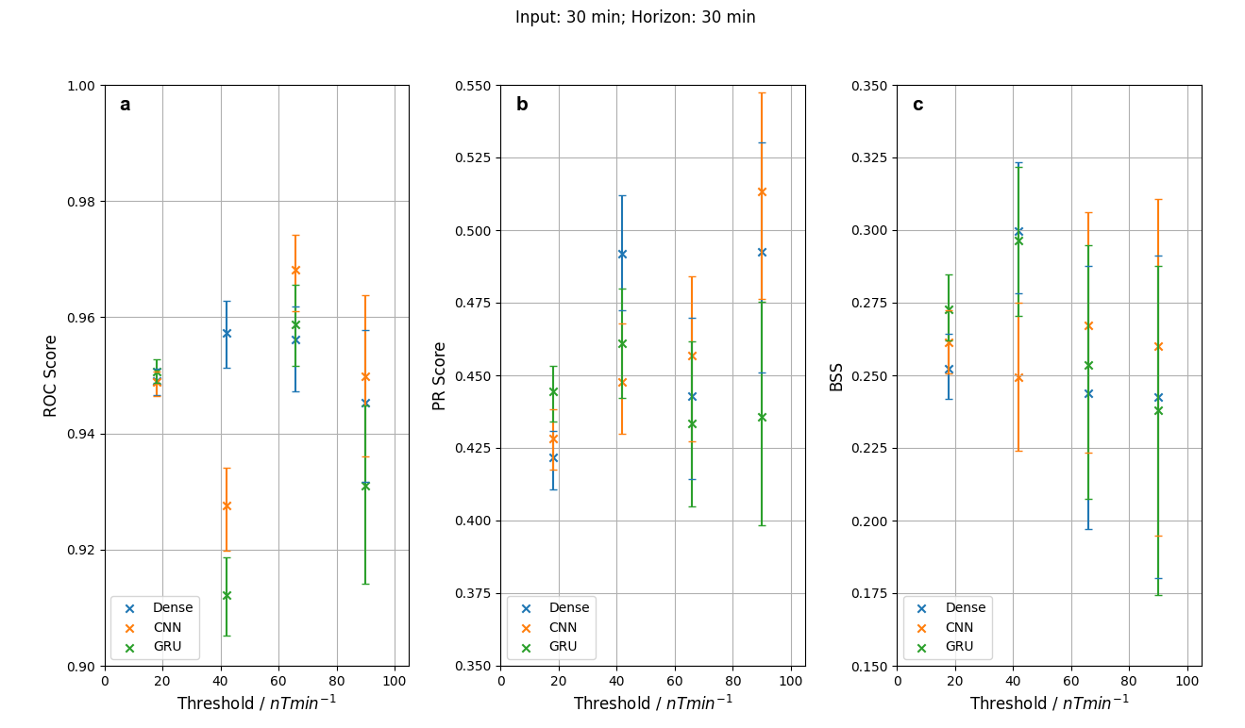
Metrics
Model “Reliability”
Model “Skill”
Smith et al., 2021
We have probabilistic predictions, so we can use the ROC score, P-R score and BSS to evaluate performance.
Notes:
Evaluate over test set, series of metrics
Skill
ROC score (between 0 and 1)
Precision Recall (0 and 1) – imbalanced data sets
Reliability
Brier Skill Score (-inf and 1)
ROC, PR and BSS are good in general
Often no statistical difference between the models
Errors from bootstrapping -> wider as we get to higher thresholds
Some dropoff at larger thresholds due to class imbalance

Slide 8
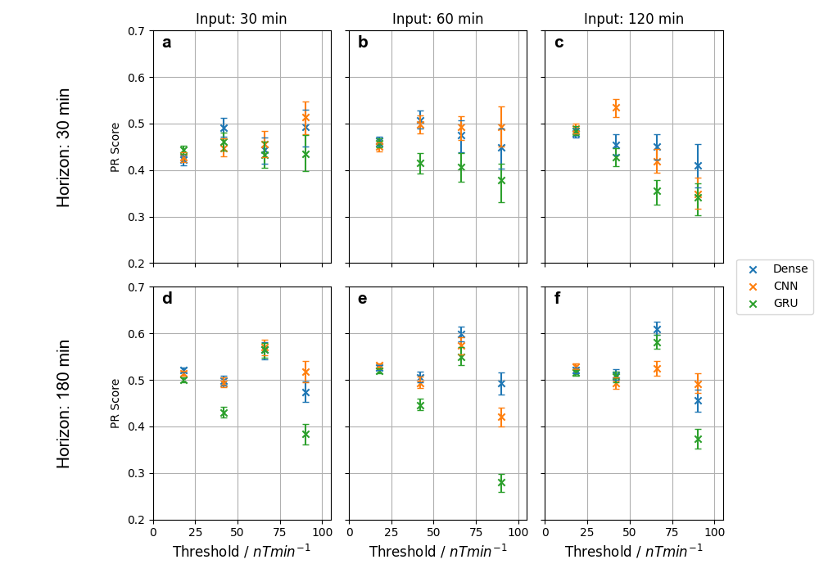
Metrics – Precision/Recall
Smith et al., 2021
Notes:
So what happens if we provide more data?
Just looking at PR for now
Architectures are fixed for this test
Increase in lower thresholds, reduction in higher thresholds due to class imbalance
Horizon increased - moving down row, see some increase in performance.

Slide 9
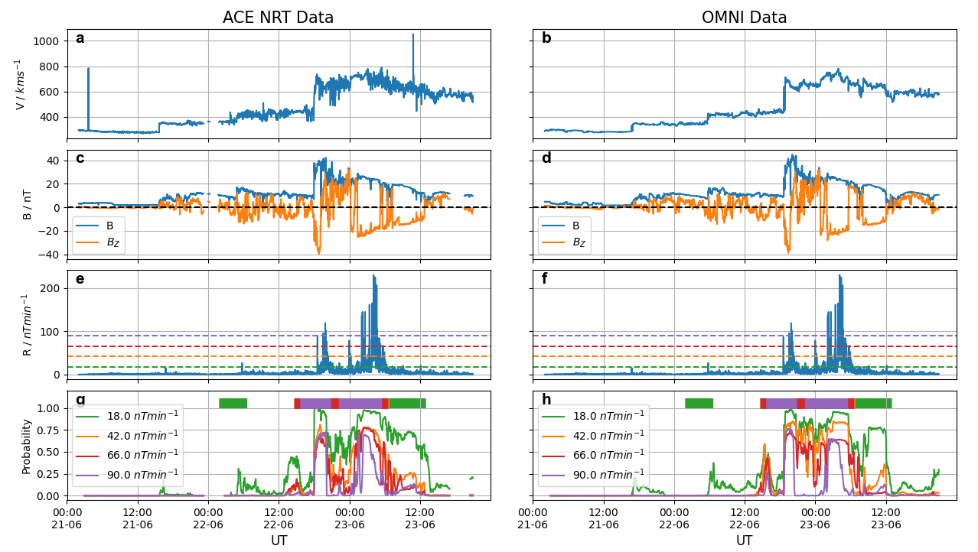
NRT Solar Wind Data
Smith et al., 2022
(under review)
Notes:
Left we have Near Real Time data
Right we have OMNI – processed and shifted to the bowshock.
Going down the panels we have solar wind properties, target and result of CNN model
Greater short term variability in NRT
Some spikes in the velocity
Data Gaps
Model gives qualitatively similar results, can cope with different data quality (due to training.)

Slide 10
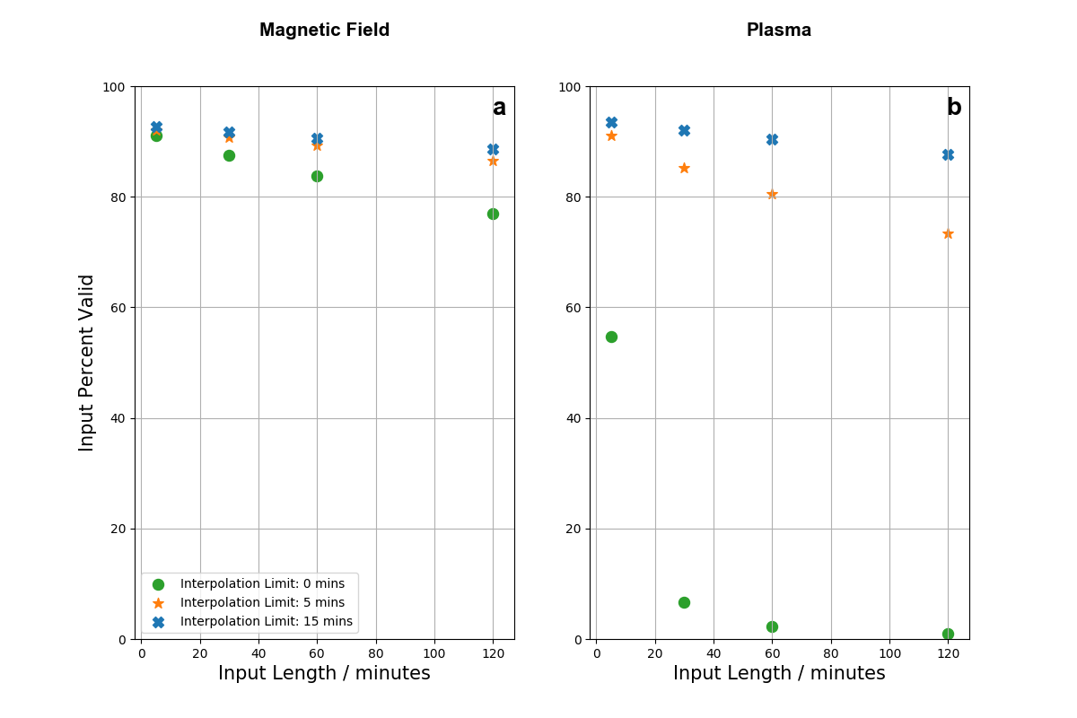
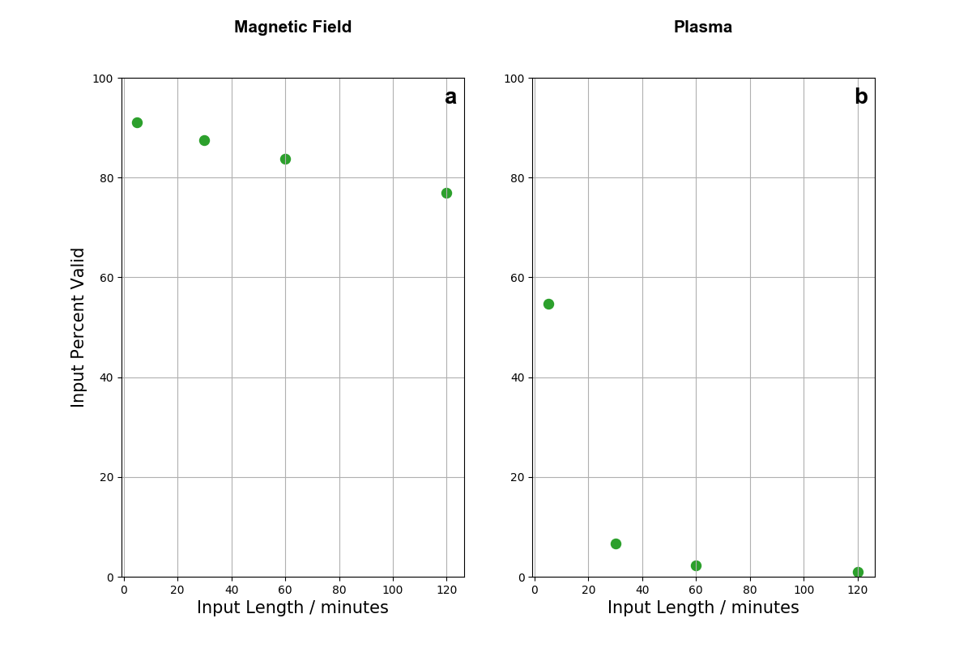
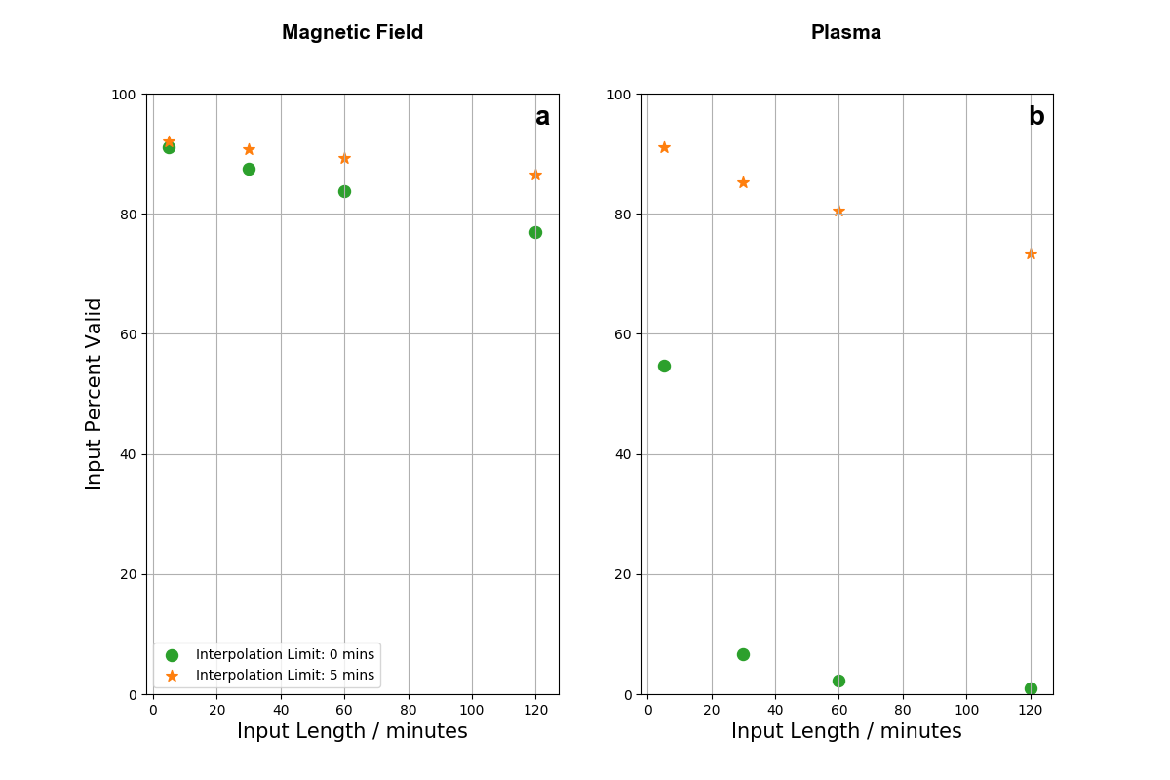
NRT Solar Wind – Data Gaps
Smith et al., 2022
(under review)
Notes:
Data gaps, much more prevalent in the NRT data.
Models generally require a period of input data, plotting that as a function of good data.
No interpolation, if you need 30 minutes of continuous data then 10% of plasma data is good, ~90% of mag
5 minutes, stark improvement
15 minutes, better again, but not as dramatic.
If you don’t want to interpolate, then it’s probably good to train a model that runs on just magnetic field

Slide 11
Summary
Forecasting potential GICs is an important Space Weather problem.
The three models tested (FFNN, CNN and GRU) perform reliably and skillfully.
At ‘extreme’ thresholds we’re limited by data availability, which limits architectures.
NRT data may show large differences to the later scientific data.
Some models seem to be able to overcome obvious data differences (if present in training).
Data gaps are an issue, interpolation can help.
andy.w.smith@ucl.ac.uk

Slide 12
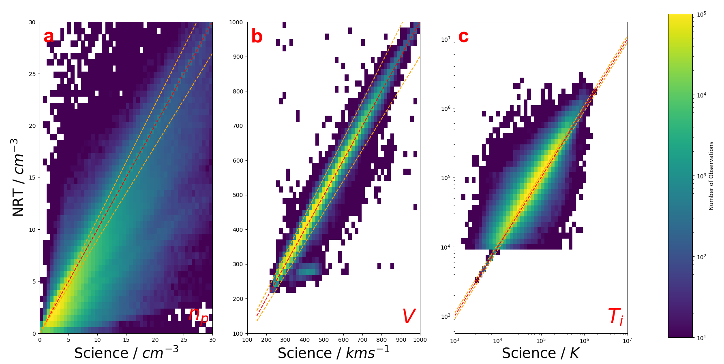
NRT Solar Wind - ACE - Plasma
Notes:
Dig a bit deeper into the NRT data
Compare science and NRT data.
Plasma components first
Histograms, if they’re equal then we’ll get a diagonal, +- 10% with orange.
Velocity best captured by the NRT data, density is pretty poor overall.

Slide 13
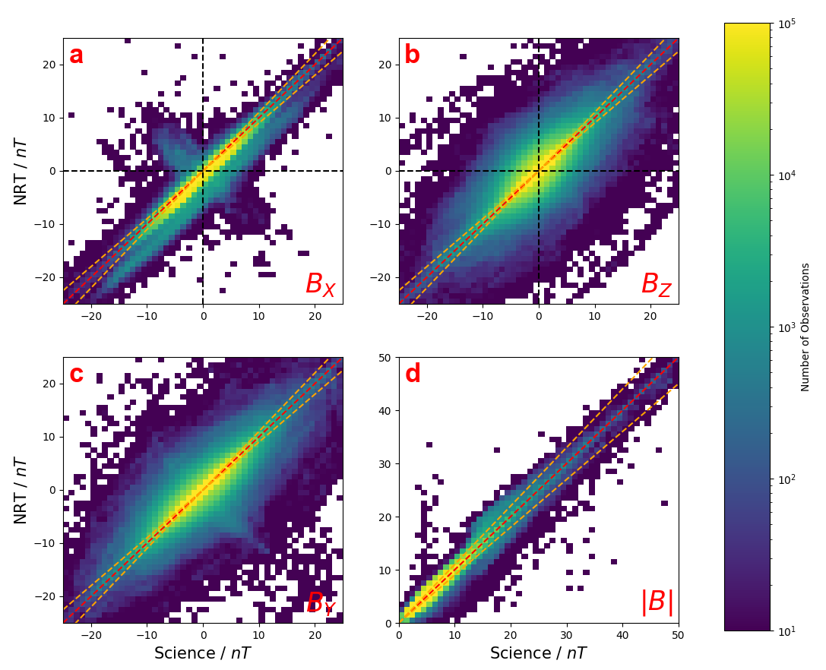
NRT Solar Wind - ACE – Magnetic Field
Notes:
Now the magnetic field.
Total field is pretty well recovered.
Issue potentially where we have wrong quadrants of Bz and Bx due to coupling functions
Short term variability coming in to play.

